Slide 1
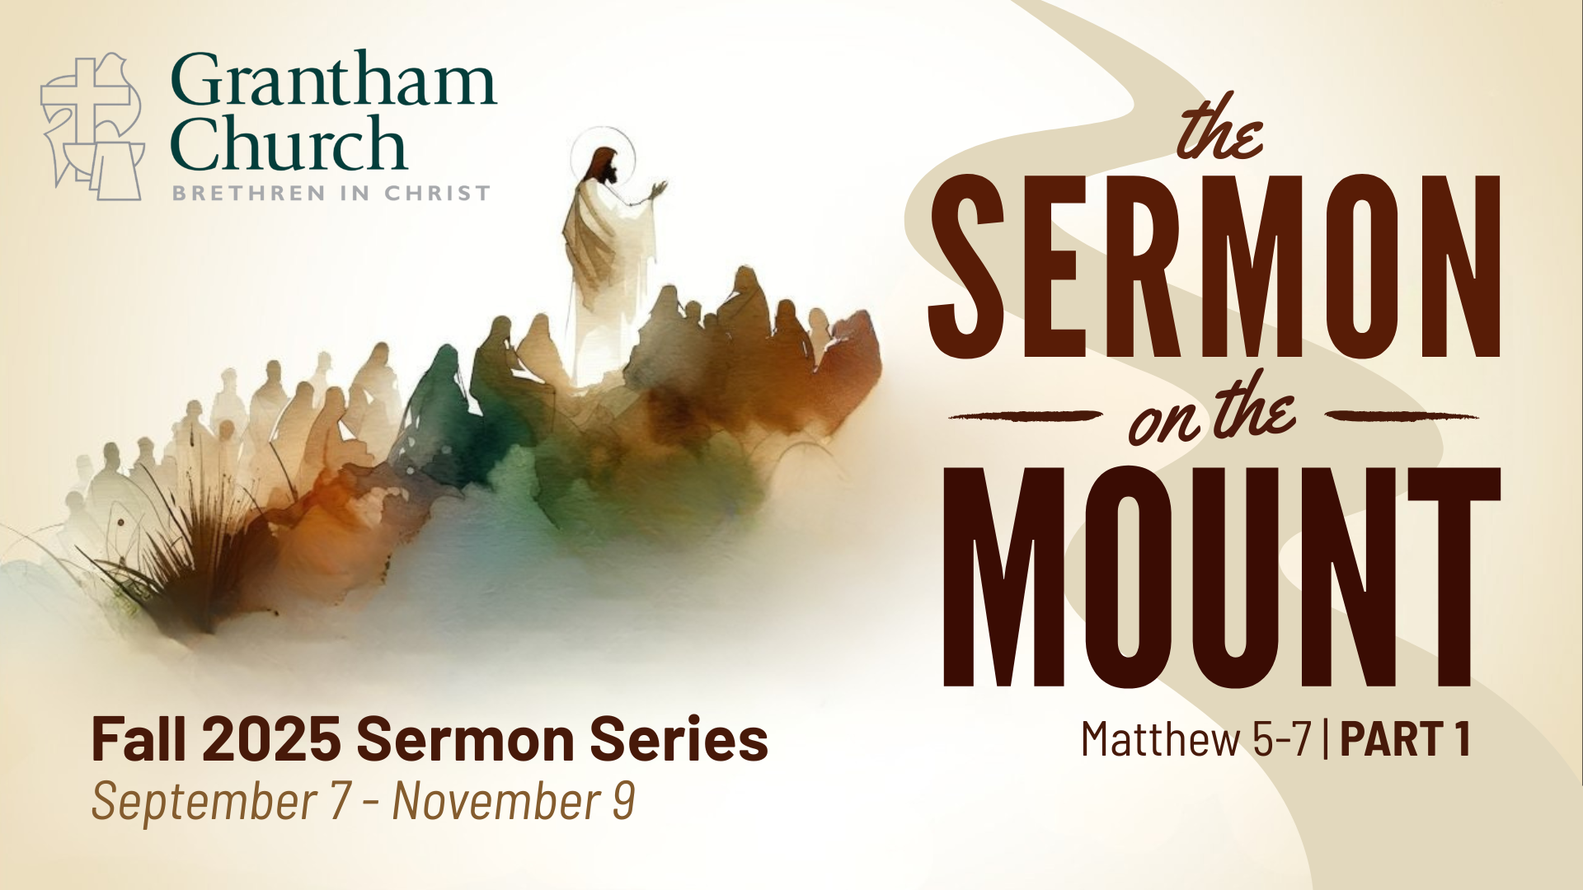
Notes:
“You are the salt of the earth. You are the light of the world. Do not think I have come to abolish the Law or the Prophets; I have not come to abolish them but to fulfill them. You have heard that it was said, ‘Love your neighbor and hate your enemy. But I tell you, love your enemies and pray for those who persecute you.’ Do not store up treasures on earth but store up your wealth in heaven. Do not worry about tomorrow, for tomorrow will worry about itself. Do not judge, or you too will be judged.” And what about the Beatitudes? The Lord’s Prayer? The Golden Rule? Or the vivid expression, “Ask and it will be given to you, seek and you will find, knock and the door will be opened to you”? All of these familiar words (and much more) can be found in what is known as the Sermon on the Mount.
In Matthew chapters 5-7, Jesus went up a mountain and a large crowd gathered to hear him preach a powerful message—proclaiming the gospel of the Kingdom and casting a vision of what it looks like to live in right relationship with God, our neighbors, and our enemies. These three chapters contain the core of Jesus’ teachings and his most well-known sayings, including some of the most rigorous ethical demands in the Bible. Today we begin Part 1 of this series, which will take us all the way to Sunday, Nov 9. So, over the next 10 weeks we will explore the message and implications of Jesus’ invitation to enter the narrow gate and follow him by living into and living out the Sermon on the Mount.
It’s no exaggeration to say that much of the world has been profoundly impacted by the teachings of Jesus in the Sermon on the Mount. From early Christianity, to the early Anabaptists, to saints like Dietrich Bonhoeffer, Corrie Ten Boom, Martin Luther King Jr., and Bono, as well as non-Christians like Nietzsche, Tolstoy, Ghandi, Bob Marley, and others. American theologian and Harvard professor Harvey Cox once said that the Sermon on the Mount is, “the most luminous, most quoted, most analyzed, most contested, and most influential moral and religious discourse in all of human history.”
And listen to what other Christian leaders throughout church history have said about the Sermon on the Mount… [NEXT SLIDE]

Slide 2
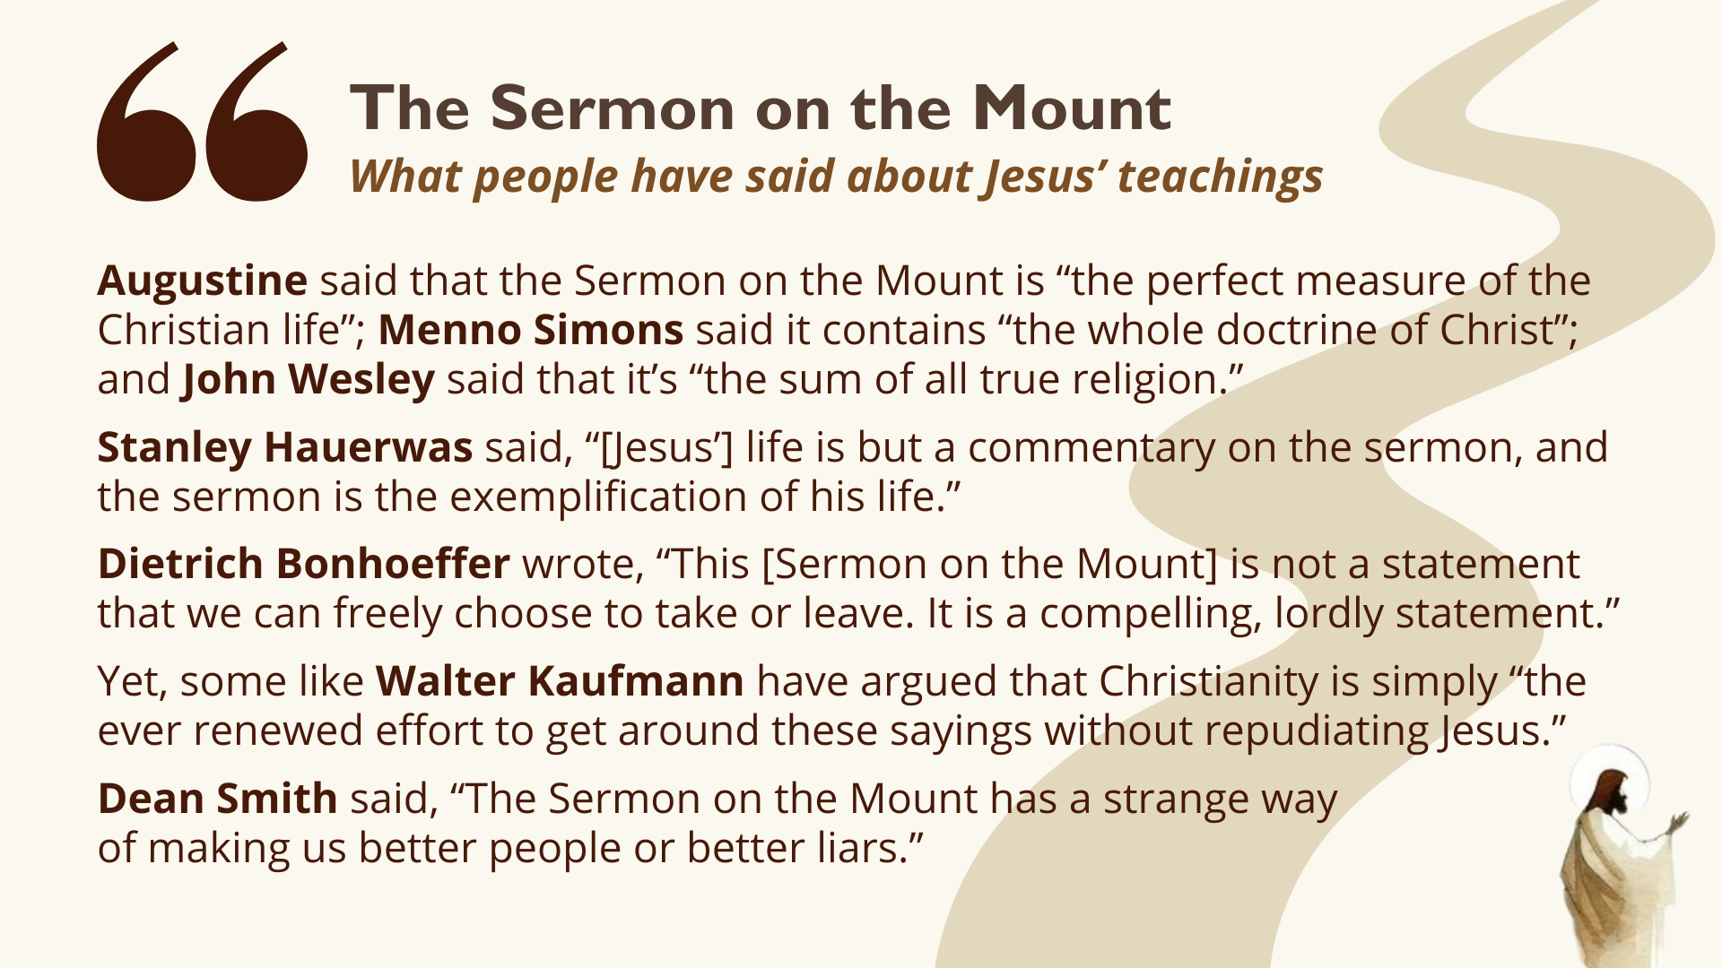
Notes:
[READ QUOTES & COMMENT]
And as much as we are challenged by the teachings of Jesus, we still believe that he and he alone has the words of life. That’s why some of you, like me, have made your way into an Anabaptist church and denomination… because you feel that you discovered a sacred space and a Christ-centered community that (though not perfect) is willing to take the teachings of Jesus seriously, unlike others who use his name but ignore his commands.
Therefore, with open minds and hearts ready to receive the words of Jesus—in order that we might become more like him through the power of the Holy Spirit—let’s begin the first message of our series with a brief introduction to the background, context, and purpose of the Sermon on the Mount in the Gospel of Matthew… [NEXT SLIDE]

Slide 3
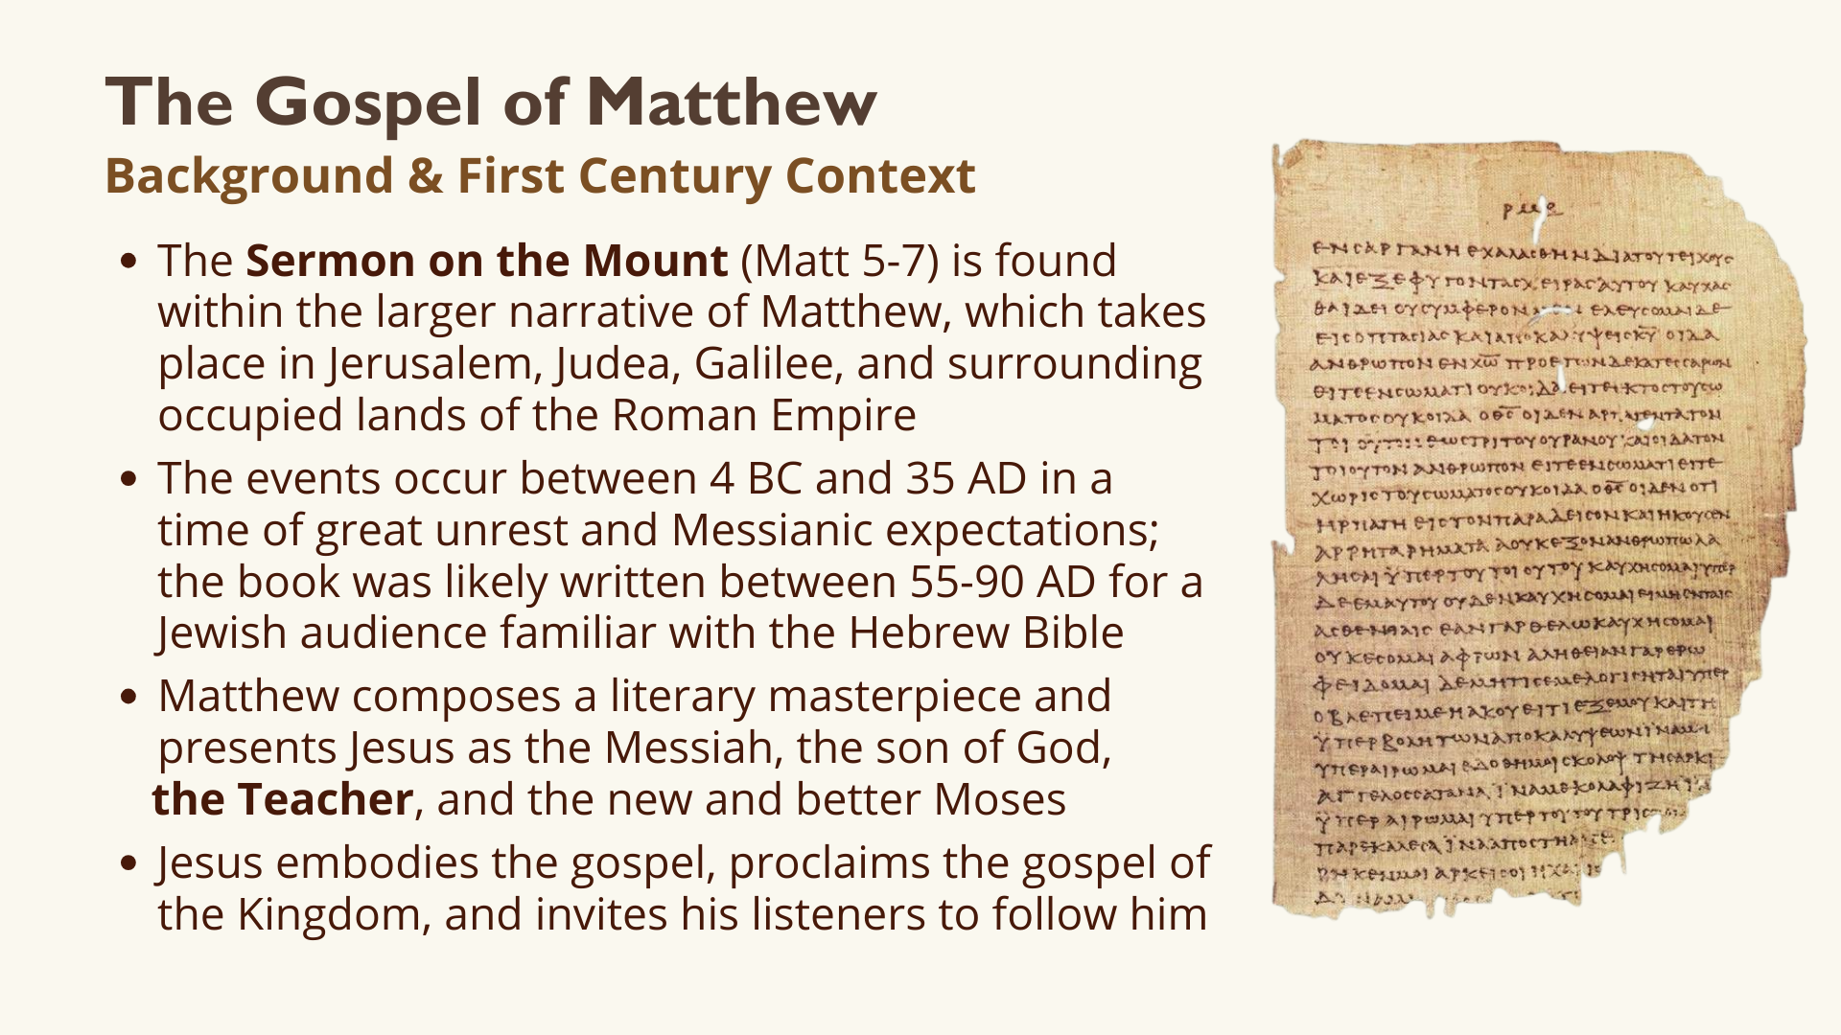
Notes:
[READ & COMMENT ON CONTEXT]
If you’d like to dig deeper into the background and context of Matthew and the Sermon on the Mount, be sure to check out some commentaries and books that we have on the shelf in the lobby, as well as the helpful videos produced by the BibleProject. I’ll be sharing resources with you each week in the series through the weekly email and linked with the sermons.
Here is the big idea in Matthew 5-7… [NEXT SLIDE]

Slide 4
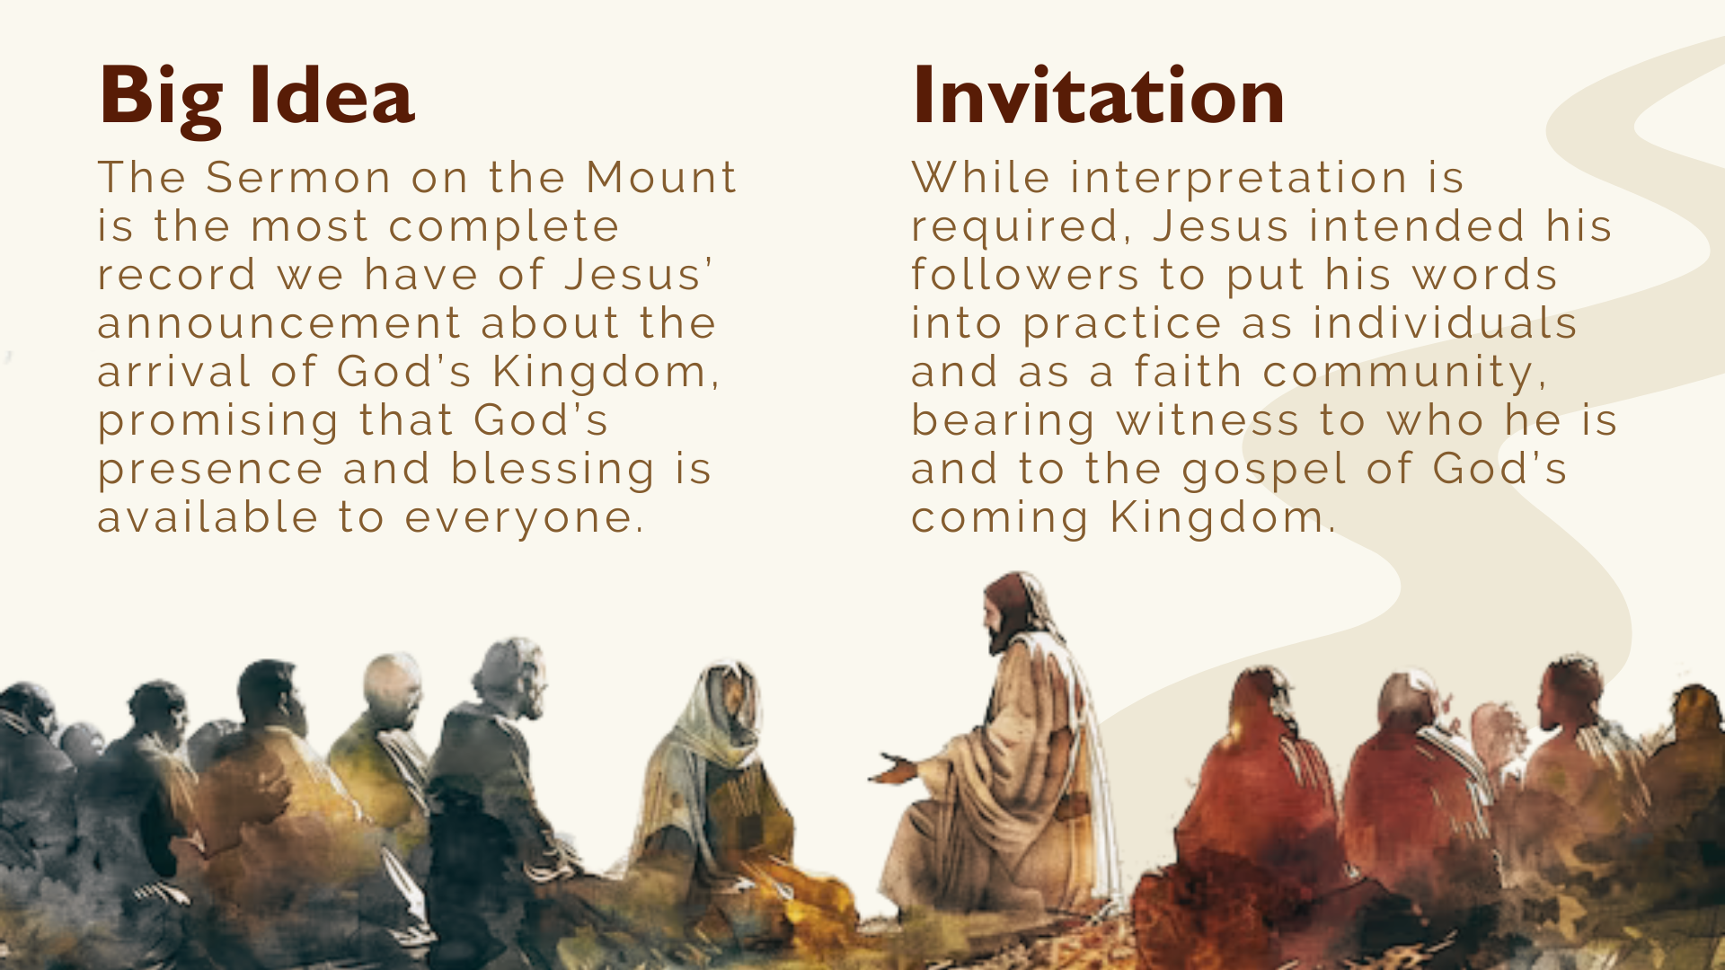
Notes:
[READ & COMMENT]
But can we really practice what Jesus preached? The pendulum has swung back and forth throughout church history: Jesus’ teachings are fully realizable vs. they’re conditional and only partially realizable. Some have even believed it’s only a picture of things to come.
Martin Luther believed that the Sermon on the Mount was ultimately an impossible idea; he called it a “counsel of despair” or a list of instructions that no one could follow
The early Anabaptists responded by saying you Protestants want to simply rest in grace when we are seeking to walk in resurrection life with the help of the Holy Spirit
And of course, Dietrich Bonhoeffer, the Lutheran theologian and pastor, prophetically chided the German church during the reign of the Nazis for not taking the teachings of Jesus more seriously, which is one reason they were so susceptible to Hitler; you can read his classic work on the Sermon on the Mount in his book, The Cost of Discipleship.
John Stott, in his book Christian Counter-Culture, wrote that the standards of the Sermon on the Mount are attainable, “but only by those who have experienced the new birth.” And so, keep in mind, these teachings of Jesus can only be obeyed in the power of the Holy Spirit. In fact, it is our own power, our own understanding, and our own thinking that we must turn from, as well as our sin, if we’re going to follow Jesus. Listen to what Jesus says in Matthew chapter 4, which sets us up for his teachings in chapters 5-7… [NEXT SLIDE]

Slide 5
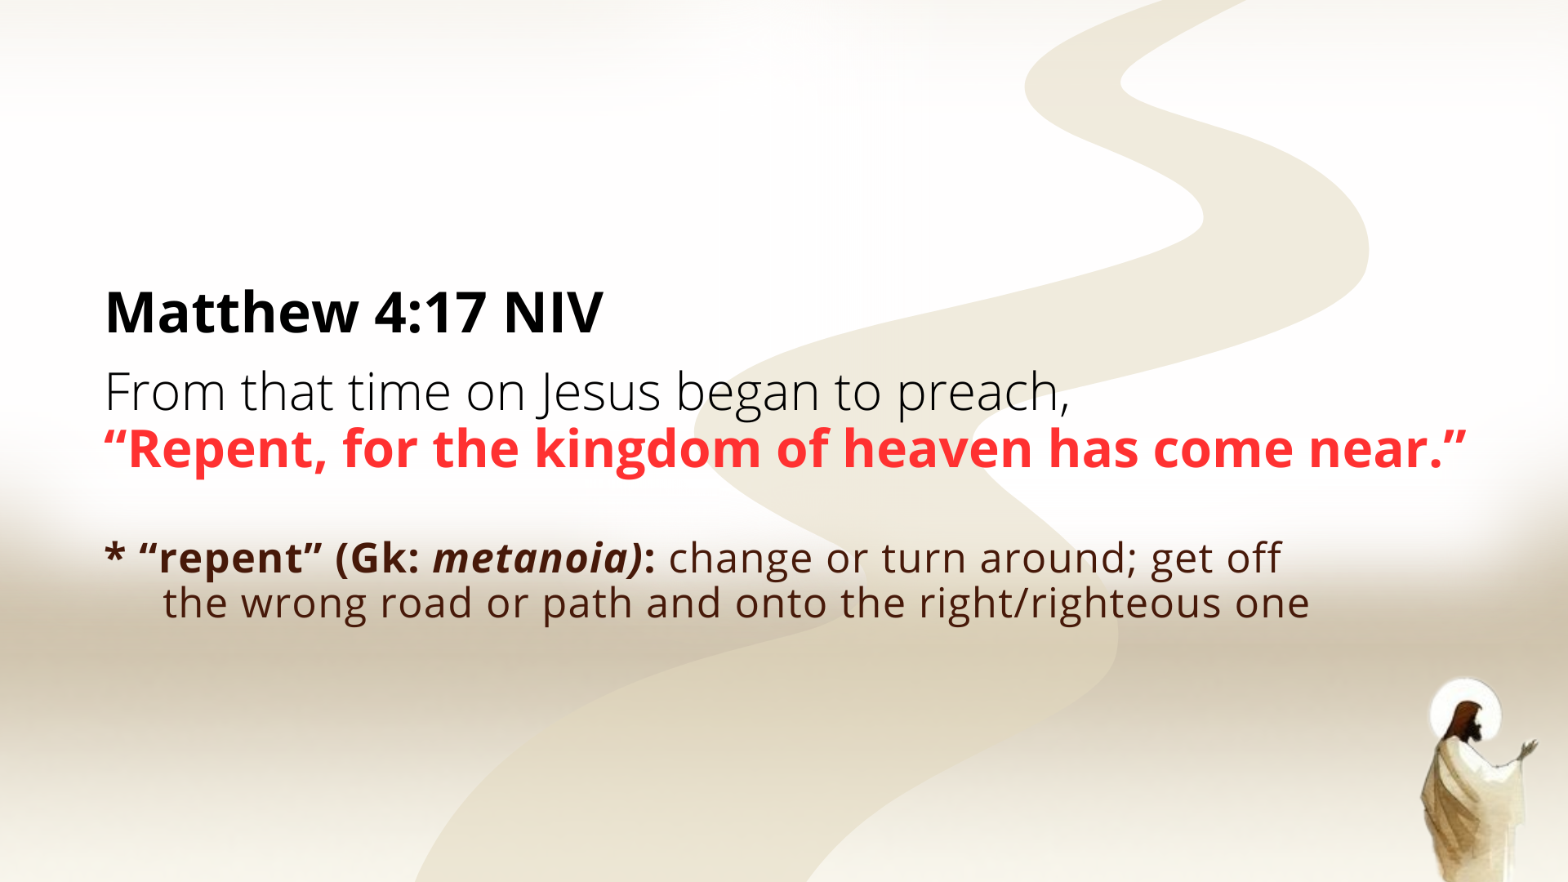
Notes:
[READ & COMMENT]
“Repent” – (metanoia): change or turn around; get off the wrong road or path and onto the right one—the way of living in right relationship with God, neighbor, and enemy
“the kingdom of heaven” – ”king-dom” i.e., the “the domain of the King; or the reign and rule of the true King, which is from heaven; God’s space, marked by pure love and light, where all things are in conformity to his will and ways; note: Matthew, for the most part, uses “kingdom of heaven” and “kingdom of God” synonymously
”has come near” or “is at hand” – meaning, God’s reign and rule has come in Jesus
And then a few verses later, in chapter 5, Jesus will begin the Sermon on the Mount. The Sermon on the Mount? Is it a sermon, as we normally think of sermons? Well, not exactly. Listen to what Jewish scholar Amy-Jill Levine says in her book… [NEXT SLIDE]

Slide 6
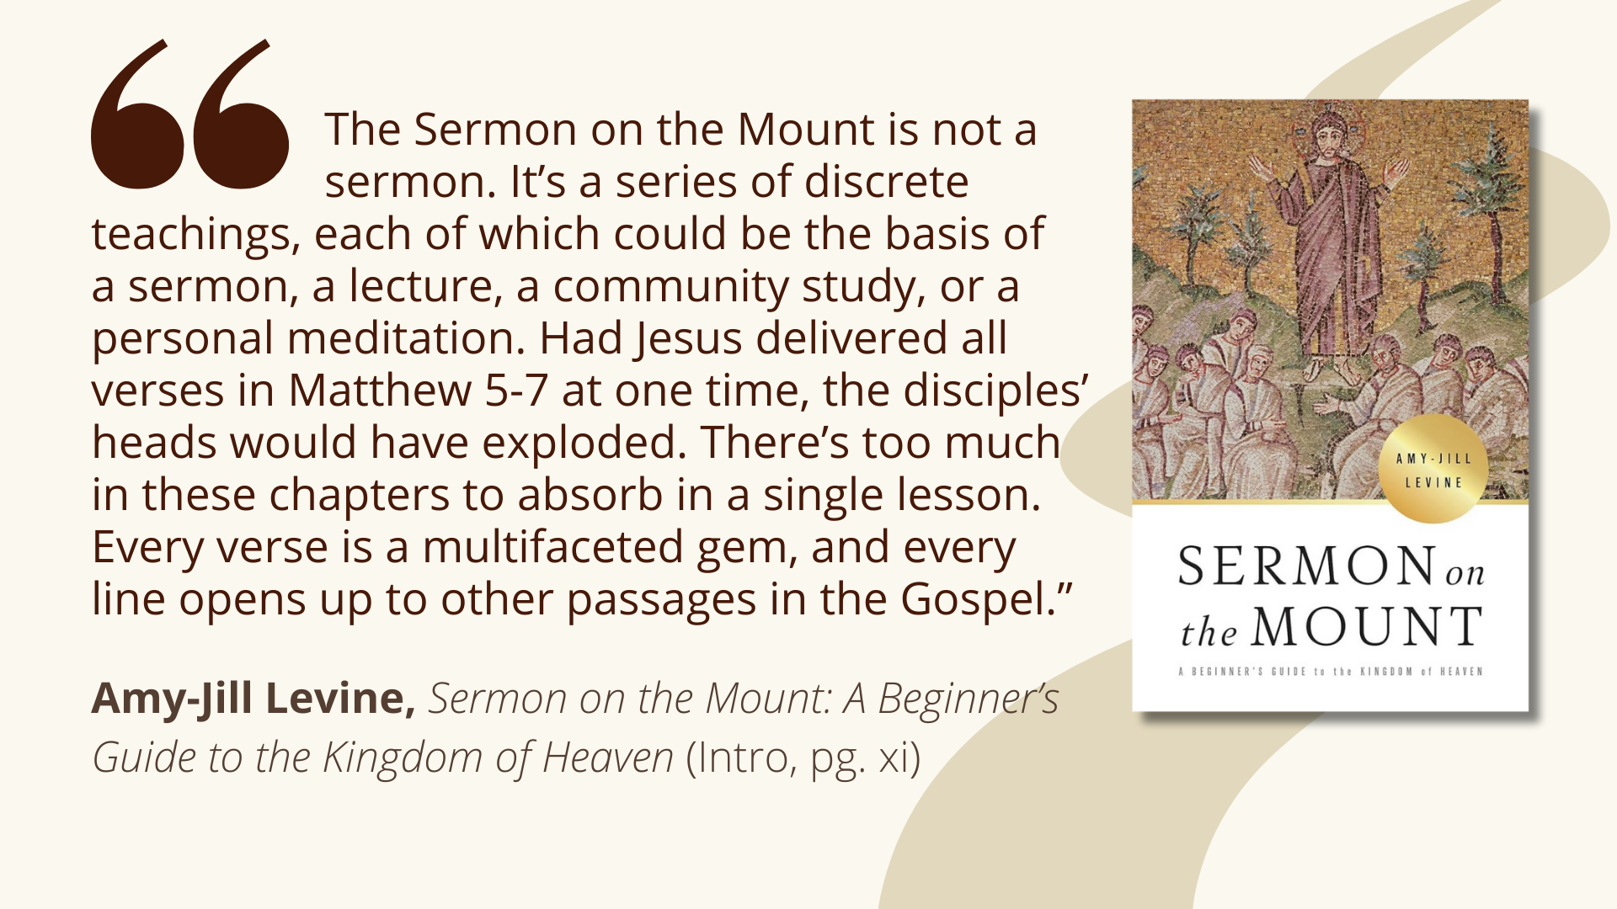
Notes:
[READ QUOTE & COMMENT]
In other words, according to Levine, the Sermon on the Mount is Jesus’ greatest hits. And since each teaching is deep, it requires extra time and space to reflect and respond. That is why it’s going to take a total of 17 weeks to cover the entire collection of Jesus’ teachings, which we will continue to refer to as, The Sermon on the Mount.
And check out this detailed breakdown of the 3-part structure of Matthew 5-7… [NEXT SLIDE]

Slide 7
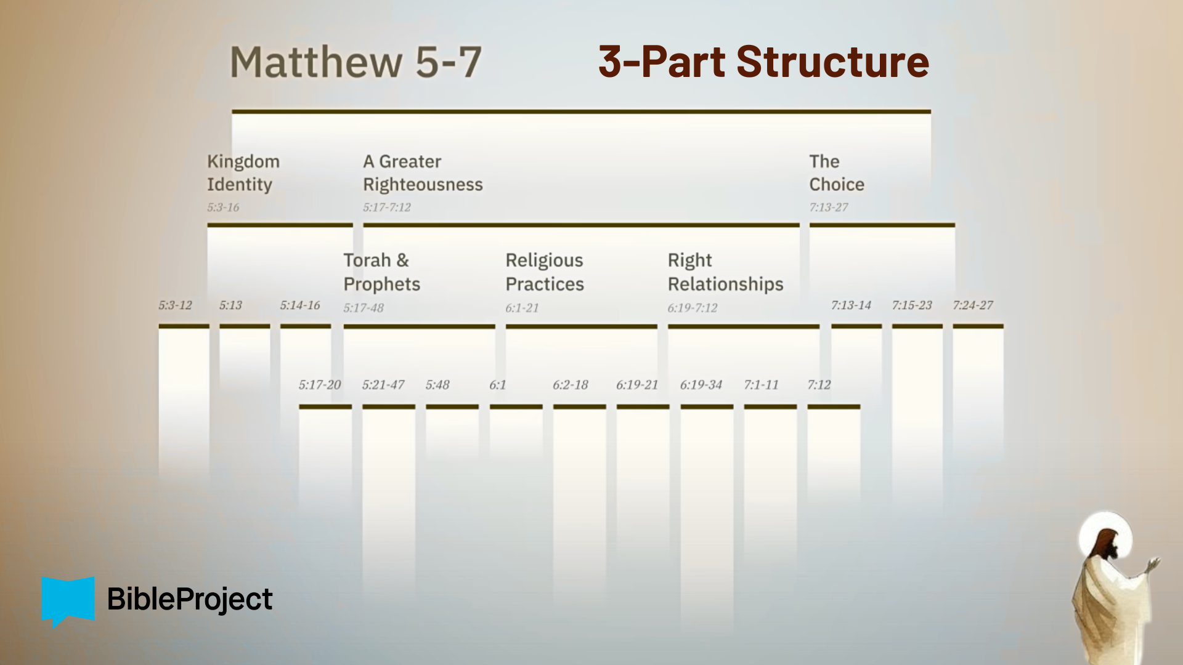
Notes:
Over at the BibleProject, they tell us that the Sermon is organized intentionally to help readers understand major points and to aid memorization. There is a 3-part repeated structure to the sermon. It contains 3 major sections, and the middle section (main body) itself has 3 parts, and each middle part breaks into 3 parts, as well.
There is an opening description of those who are being invited into his Kingdom and the sort of folks that God blesses, which we will see next week in the Beatitudes
Then the main body of the sermon, which describes what it looks like to live in right-relationship with God, our neighbors, and our enemies
And a conclusion that invites listeners to choose how they will respond
While Jesus certainly could have organized his sermon in this way (as we see it portrayed in the series, The Chosen), as we observe the overall complex structure of Matthew’s gospel, it seems most likely that Matthew compiled it into the form we have.
And now, like a movie that starts with the ending, we’re going to begin the SotM with the first two verses of the conclusion (the choice), so that we will move through Jesus’ teachings with the end in mind. If you’re taking notes… [NEXT SLIDE]

Slide 8
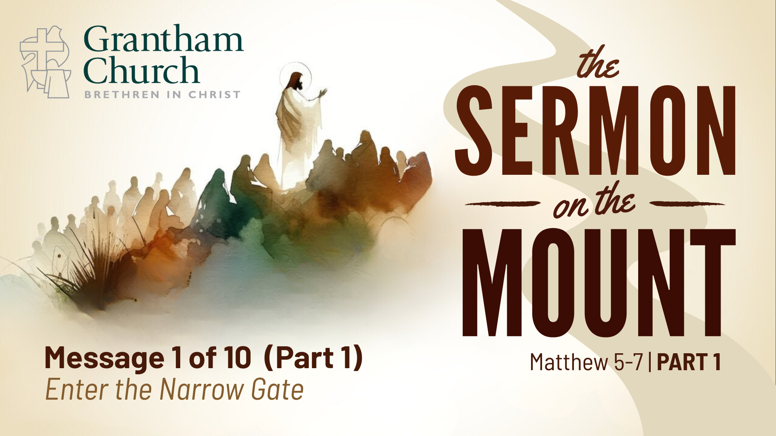
Notes:
…and you haven’t already noticed it in your bulletin, I’ve entitled this message, Enter the Narrow Gate.
Let’s open our Bibles to the Gospel of Matthew, chapter 7… [NEXT SLIDE]

Slide 9
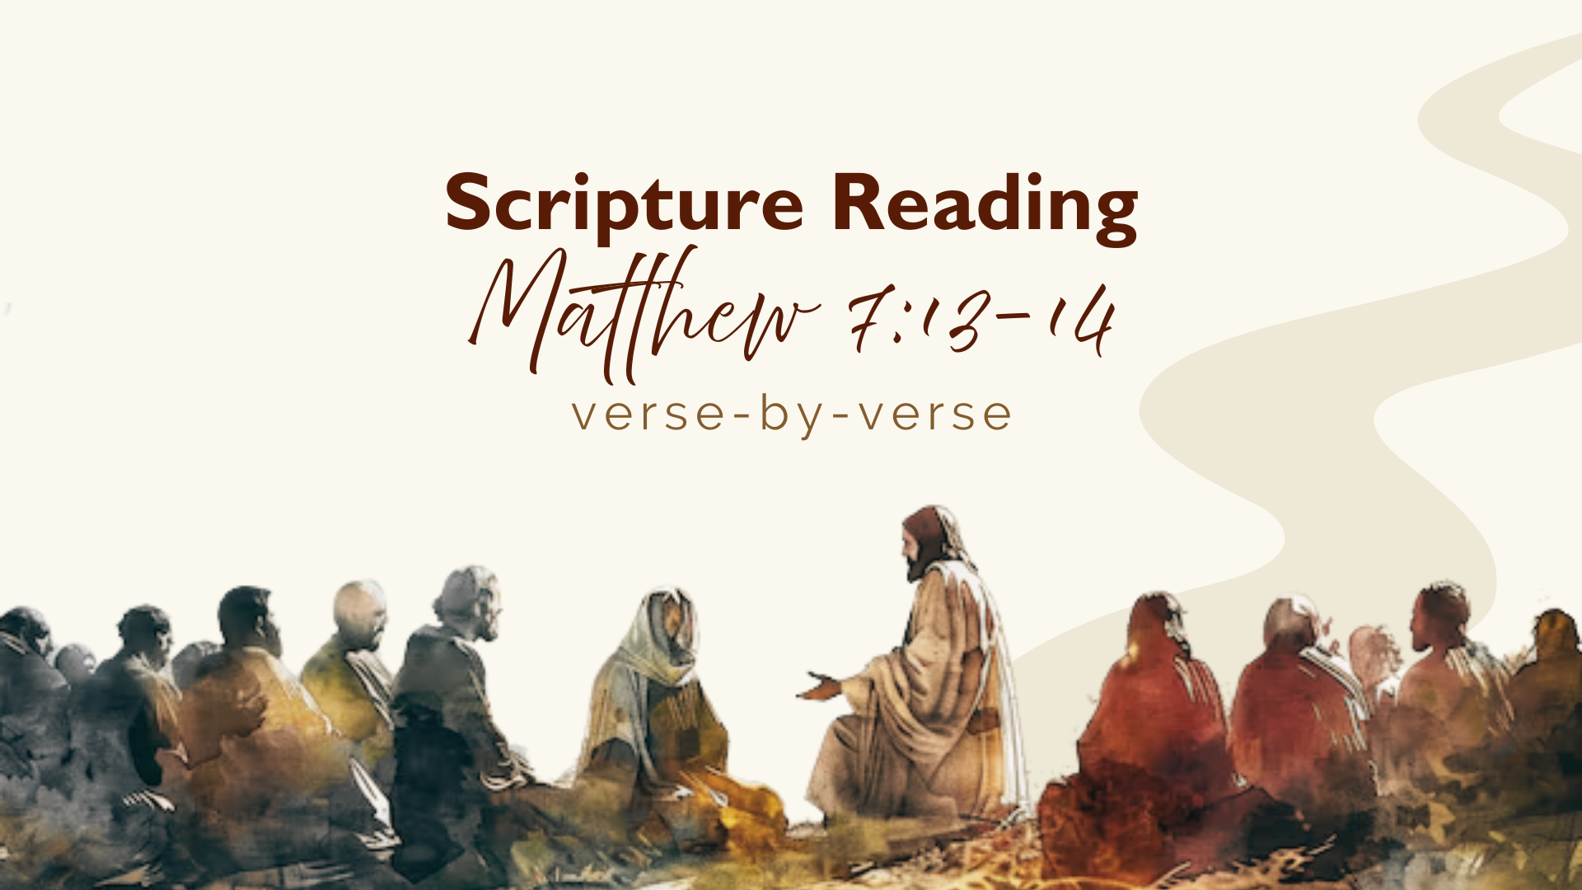
Notes:
[INVITE CONGREGATION TO STAND FOR READING]
[READ MATTHEW 7:13-14]
This is the Word of the Lord. Thanks be to God.
You may be seated. Let’s look again at these two verses… [NEXT SLIDE]

Slide 10
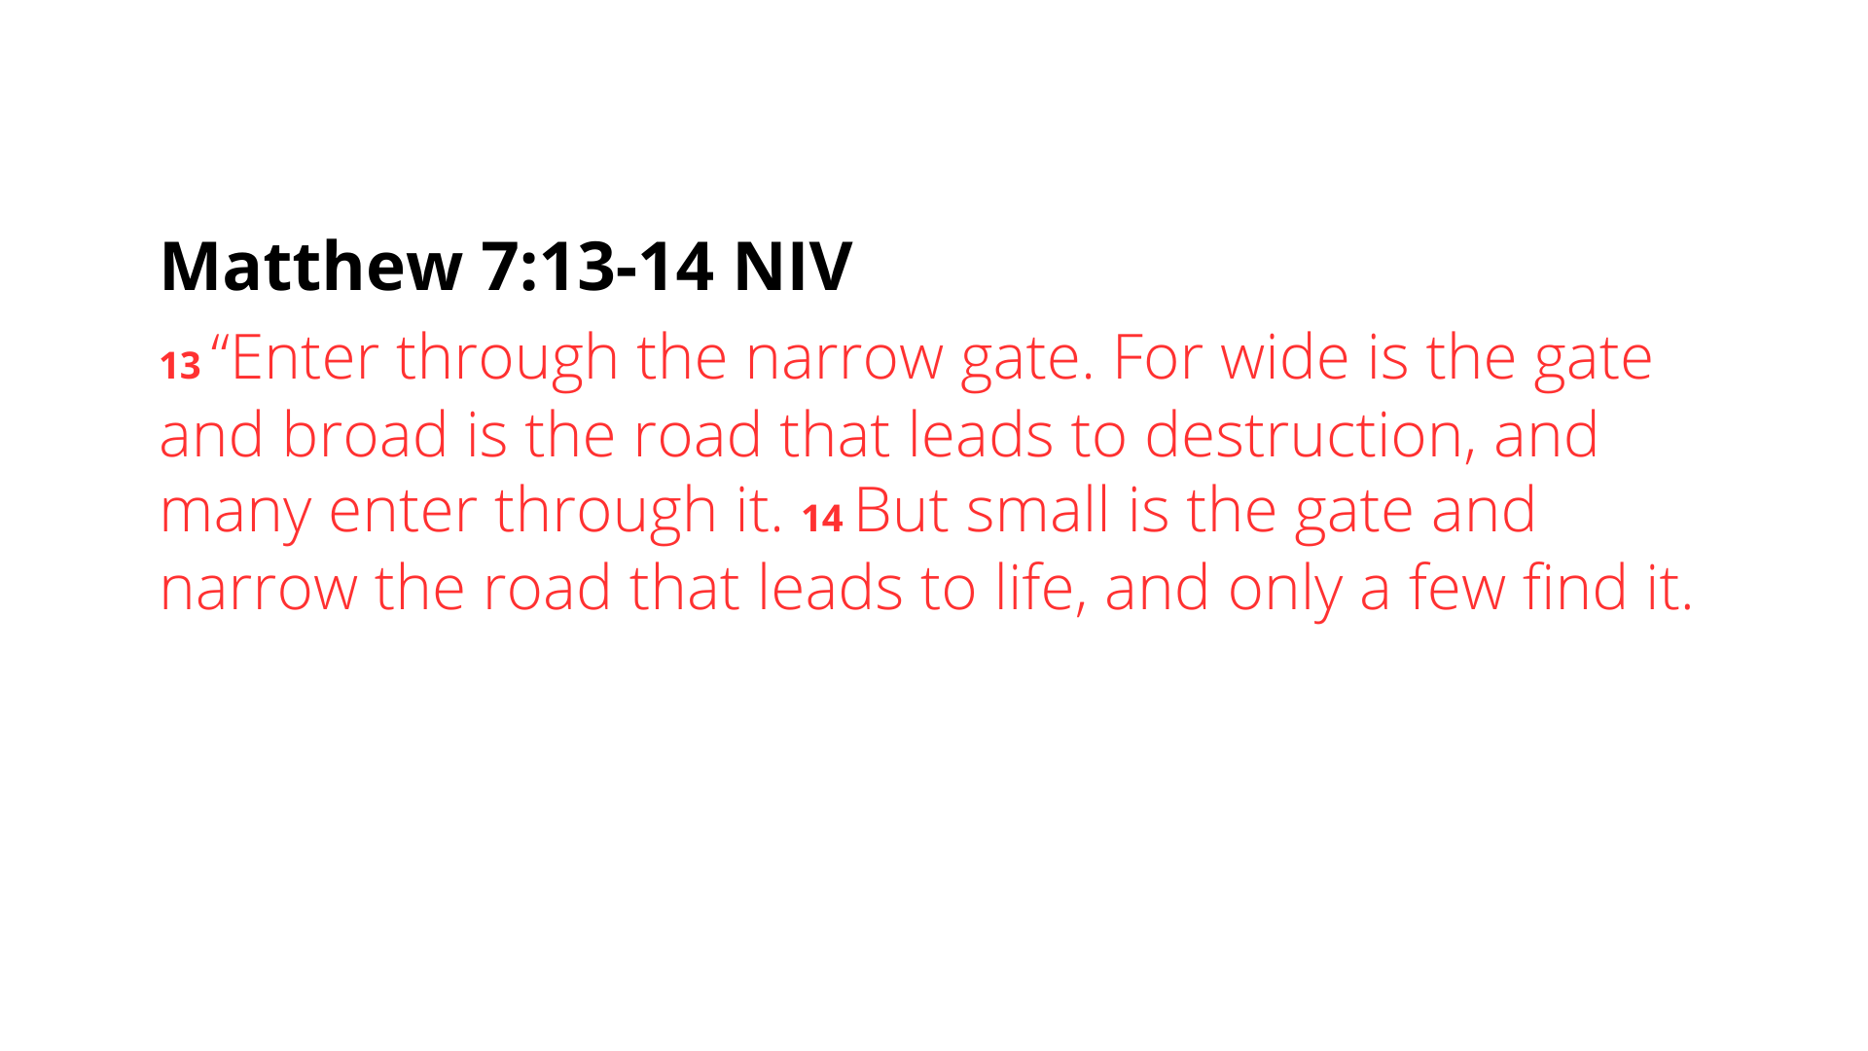
Notes:
[READ & COMMENT]
“gate” – the gate Jesus’ audience would be thinking of here is the gate going in and out of a city. Gates were archways with doors. In the first century, Jerusalem probably had between 10-12 gates around the walled city. And some of these gates were different sizes and, depending upon which gate you went out, it led to a different place
Notice the contrast between the narrow and wide gates; a broad or wide gate would signal to the traveler that this is a main road (e.g., like the interstate or toll road – more people, more conveniences, and likely safer in the mind of the traveler); a lot of folks travel it; But the “narrow” or small gate is going to lead to a narrow (less-traveled) road, with fewer people, and likely more winding and uncertain in places.
And yet, it isn’t the wide road and well-worn path that leads to life (no, that leads to destruction); instead, it’s choosing the unexpected narrow gate and path that leads to life in the Kingdom; It’s counter-intuitive; it’s counter-cultural; but it’s the gospel.
Also, when Jesus speaks of entering through the “narrow” gate and walking the narrow road that leads to life, it’s important to note that “narrow” can mean “to squeeze” something; the narrow gate and path is a “constricted” one at times. In other words, the narrow way of Jesus will lead you into social situations that will squeeze you and constrict (or cause suffering) as it will require a denial of your flesh and a dependence upon the Spirit of God to be faithful in the face of opposition and pressure to do otherwise. But again, this is, according to Jesus, and his words in the Sermon on the Mount, the way to life.
And how do we know what path we’re on? Well, based on what we will hear Jesus say in Matthew 5-7, there are signs in our life... [NEXT SLIDE]

Slide 11
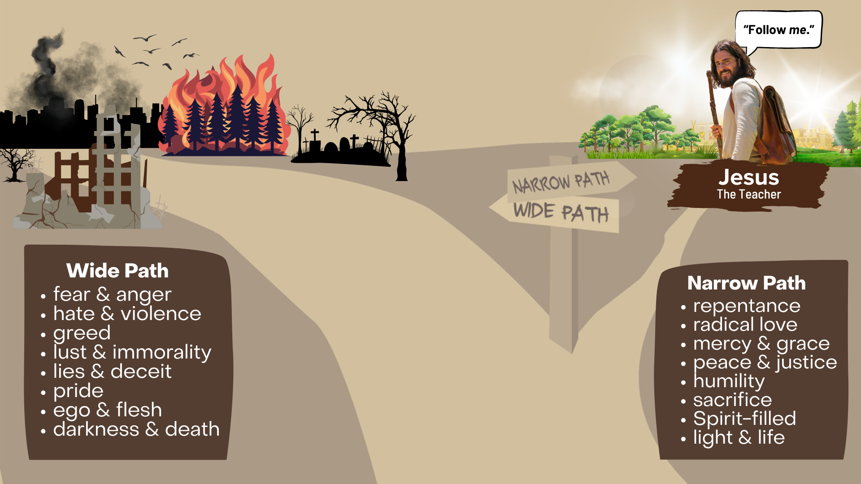
Notes:
As you can see depicted in this image, there is the wide path of the world and the narrow path of Jesus. One leads to life, and one leads to ruin and destruction. According to what we will read in the Sermon on the Mount, you may be on the wide path if you are embracing the way of that path. Are you choosing to walk the way of the world and feeding into fear, anger, hate, violence, greed, lust and immorality, lies and deceit, pride, ego and the flesh, which all leads to darkness and death? Or are you walking the narrow path that isn’t simply about changing your behavior, but dealing with inner transformation of the heart? Are pursuing repentance, learning to love like Jesus, practicing mercy and grace, being peacemakers and promoters of justice; allowing God to work humility into your life, learning to sacrifice for others, and live a Spirit-filled life of light and love?
Jesus is saying, life is a journey on a path. Choose carefully. Because your life decisions will lead you along a certain path. And those decisions will shape and form who you are becoming. As the first two verses of the Psalms say: “Blessed is the one who does not walk in step with the wicked or stand in the way that sinners take or sit in the company of mockers, but whose delight is in the law of the Lord, and who meditates on his law day and night.”
And you know, the first time “the way” or road is used in the Hebrew Bible is to describe the way in and out of the garden of Eden (Gen.3:24); and of course, Eden was a paradise on earth, before sin and death came into the world. And so, this narrow gate and path that Jesus speaks of… will eventually lead us back to Eden, or as the NT calls it—the new heaven and earth. The narrow path leads us to eternal life. Therefore, enter the narrow gate.
And so, let us hear Jesus’ call to discipleship later in Matthew 16… [NEXT SLIDE]

Slide 12
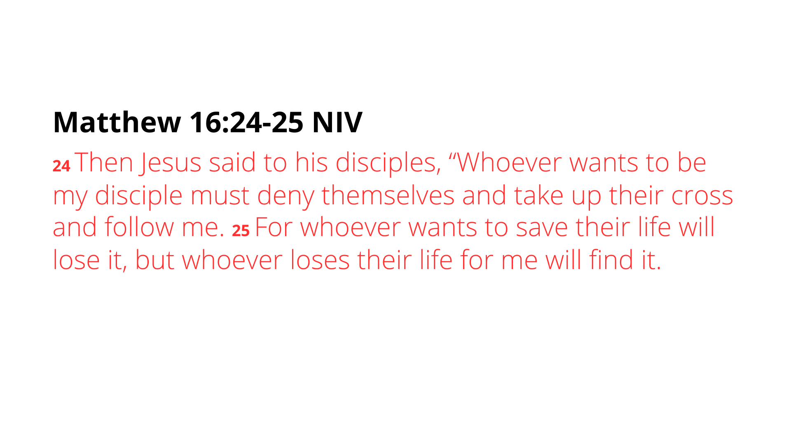
Notes:
[READ PASSAGE & COMMENT]
Yes, we must deny ourselves and be willing to carry our own instrument of death for the glory of God… i.e., some things will need to die… but for what purpose? Don’t miss this… it is to find, to discover, to gain the quality of life that only Jesus can give.
In his book, The Cost of Discipleship, Bonhoeffer wrote, “When Christ calls a man, he bids him come and die.” In other words, when Jesus calls us (as he does in the Sermon on the Mount), our old life comes to an end and our new life in Christ begins. Let it be so!
And let’s be clear. This is not about earning salvation. This is about discipleship. It’s about participating with God in the process of becoming like him. Listen to what the pastor and author Rich Villodas says in his most recent book, The Narrow Path… [NEXT SLIDE]

Slide 13
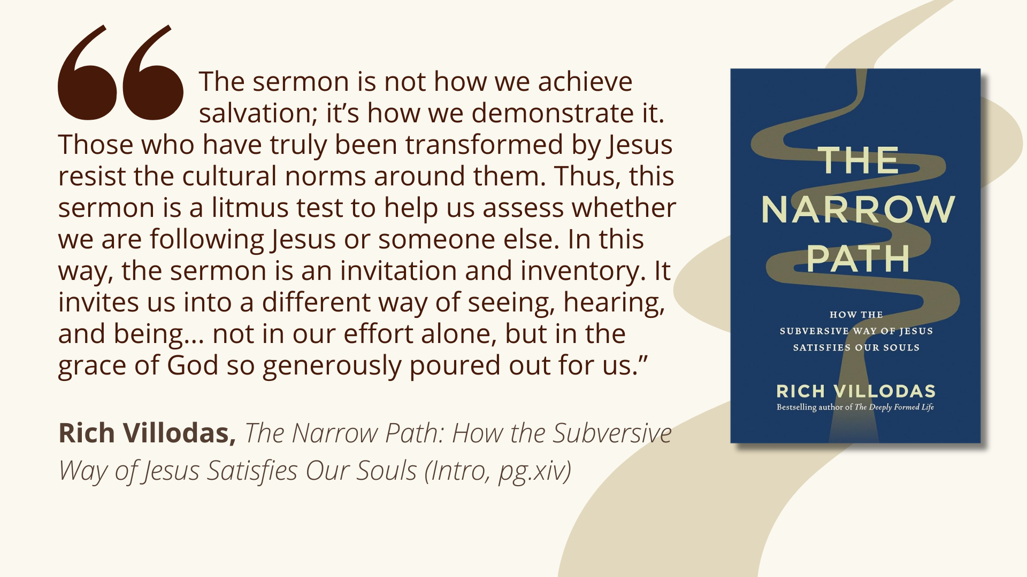
Notes:
[READ QUOTE & COMMENT]
Rich goes on to say that the Sermon on the Mount prompts us to allow the Lord to take inventory of our thoughts, words, and actions to see if they line up with God’s holy expectations and glorious vision of the Kingdom come. And so, as we consider the major themes of the Sermon on the Mount, we will be invited to ask ourselves things like:
Am I willing to go against the mainstream?
Is my definition of love the same as Jesus’?
Do I trust in the way of the cross or the way of the sword?
How can I forgive someone who has hurt me?
Am I serving God or money?
Is trust or anxiety shaping my life?
Can my word be taken at face value?
Do I bless those who curse me?
Do I have sexual integrity, in both mind and body?
Am I building my life on Christ the rock, or on sinking sand?
My friends, let us begin this series knowing that Jesus does not give us the Sermon on the Mount to tell us how bad we are, but instead to help us see that if we yield our lives to him and receive his grace for the journey… we have unlimited potential as his disciples. His words are an invitation to experience the life of heaven, and to inspire us to a greater righteousness.
Finally, here are some questions to help us reflect and respond together… [NEXT SLIDE]

Slide 14
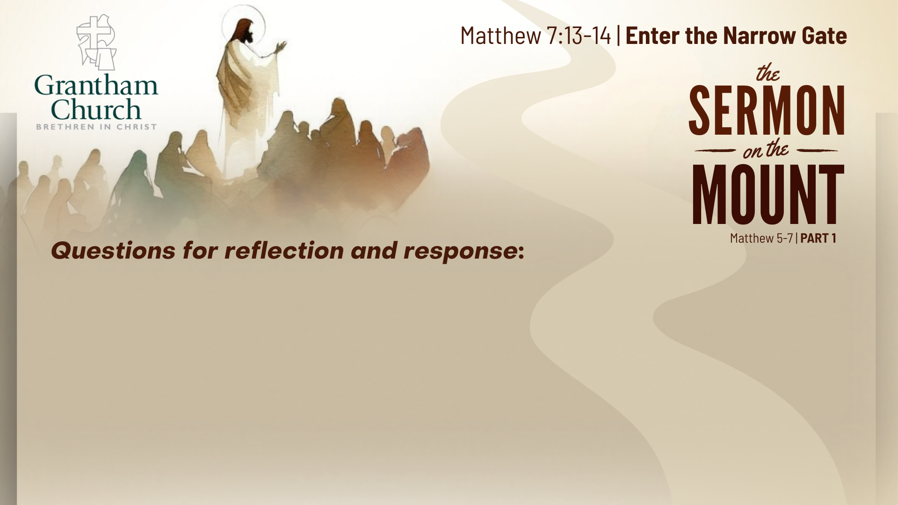

Slide 15
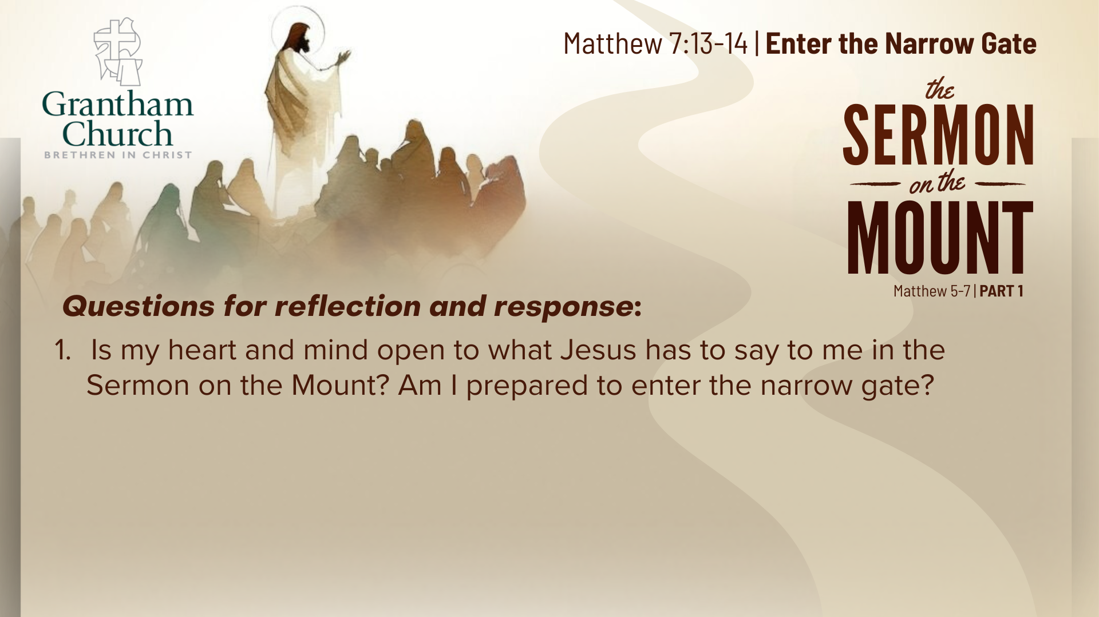

Slide 16
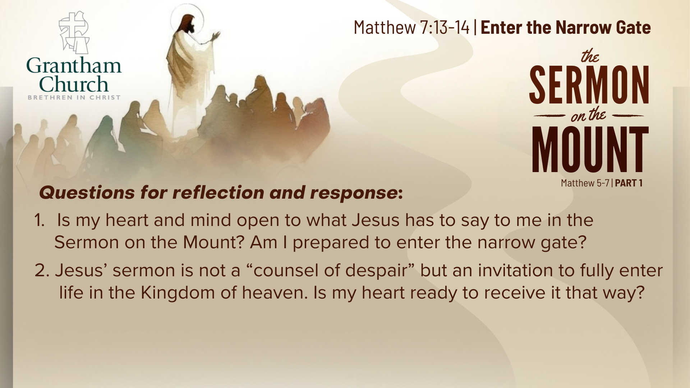

Slide 17
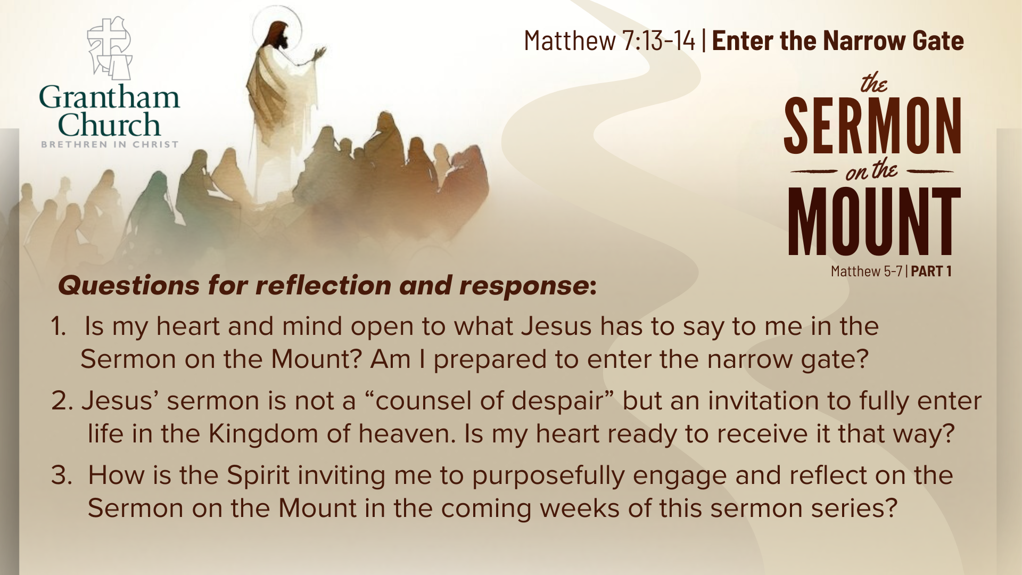
Notes:
[READ & BRIEF COMMENT ON EACH QUESTION]
Is my heart and mind open to what Jesus has to say to me in the Sermon on the Mount? Am I prepared to enter the narrow gate?
Jesus’ sermon is not a “counsel of despair” but an invitation to fully enter life in the Kingdom of heaven. Is my heart ready to receive it that way?
How is the Spirit inviting me to purposefully engage and reflect on the Sermon on the Mount in the coming weeks of this sermon series?
[CLOSING WORDS]
Let’s pray… [NEXT SLIDE FOR CLOSING PRAYER]

Slide 18
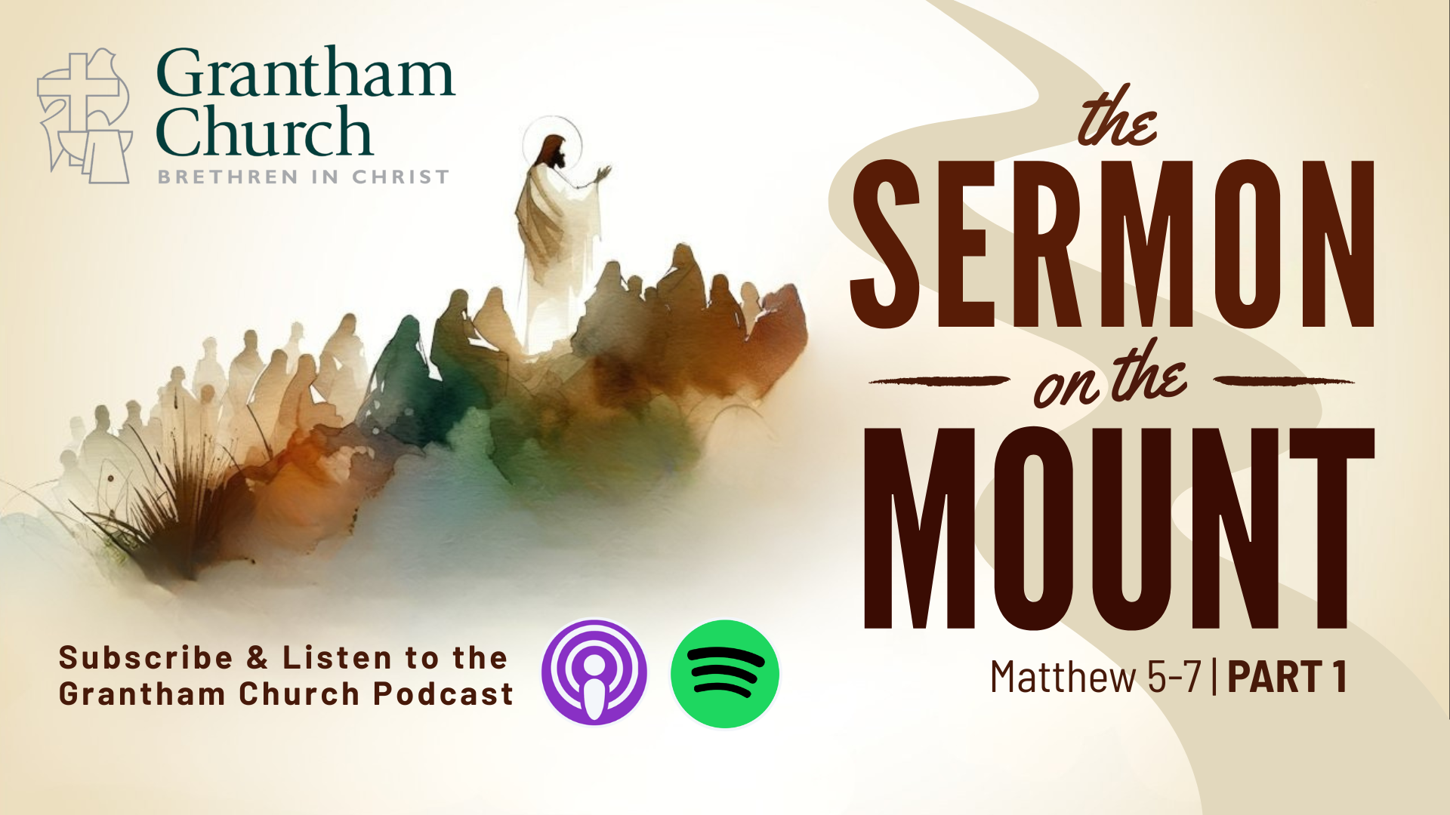
Notes:
[CLOSING PRAYER]
[APOSTLES’ CREED]
[COMMUNION]
Benediction
Brothers and sisters, you have heard the words of Jesus and the call to follow him. The path is narrow, but it leads to life. Remember that Christ walks with you, the Father surrounds you, and the Spirit empowers you. Therefore, go in peace, to love and serve the Lord. Amen.

